Slide 1


TAMPERE CONVENTION
Ratification and Implementation
July 2022

Slide 2
International Telecommunication Union (ITU)
Connect the world
3 Sectors
193
900
Specialized United Nations (UN) Agency for Telecommunications & Information and Communication Technologies (ICTs)
Member States
Companies, universities, and international and regional organizations.
​Rich network of experts in the global ICT ecosystem
Standardization
Radiocommunication
Development
Notes:
ITU is the United Nations specialized agency for information and communication technologies – ICTs.
Our main mandate it to help the world communicate, by allocating global spectrum and satellite orbits, setting technical standards and recommendations (ITU-T, which set CAP recommendation) and we help developing countries develop their telecom infrastructure and networks, but also promote the use of ICTs for development.
We bring together 193 Member States and 800 private sector entities and academic and research institutes.
Governments are represented by the Ministries in charge of telecommunications/ICTs and the regulatory telecommunication authorities.
Private sector include the telecommunication operators, mobile operators, satellite, but also the manufacturing industry and companies such as google and facebook, so newer ICT, or OTT companies.
Part of the UN System and committed to contribute to the achievement of the UN Sustainable Development Goals (SDG)s. This is a global development agenda, which was adopted in the year 2015 which identifies 17 key development areas – health, education, environment, poverty reduction, employment etc – and a set of targets that UN Member States committed to achieve. ITU is committed to make a contribution by using ICTs to help achieve these SDGs and targets. This includes the area of DDR and management, as disasters remain a key development challenge are part of this agenda.

Slide 3

Emergency Telecommunications Cluster (ETC)
Global network of organizations working together to provide shared communications services in humanitarian emergencies
1 of 11
Clusters designed by the Inter-Agency
Standing Committee(IASC)
40+
Humanitarian operation since 2005
Activated in:
Bangladesh
CAR
Libya
Pacific preparedness(Fiji)+Tonga
Nigeria
Syria
Ukraine
Yemen
Notes:
The Emergency Telecommunications Cluster (ETC) is a global network of organizations that work together to provide shared communications services in humanitarian emergencies. The ETC is one of the 11 clusters designated by the Inter-Agency Standing Committee (IASC). One of the ETC's strategic pillars is on regional and country preparedness, to improve the resilience of regional, national and community actors based on best-practice and mainstreaming the preparedness mindset.
ITU is a member of ETC.
https://www.etcluster.org/partners

Slide 4
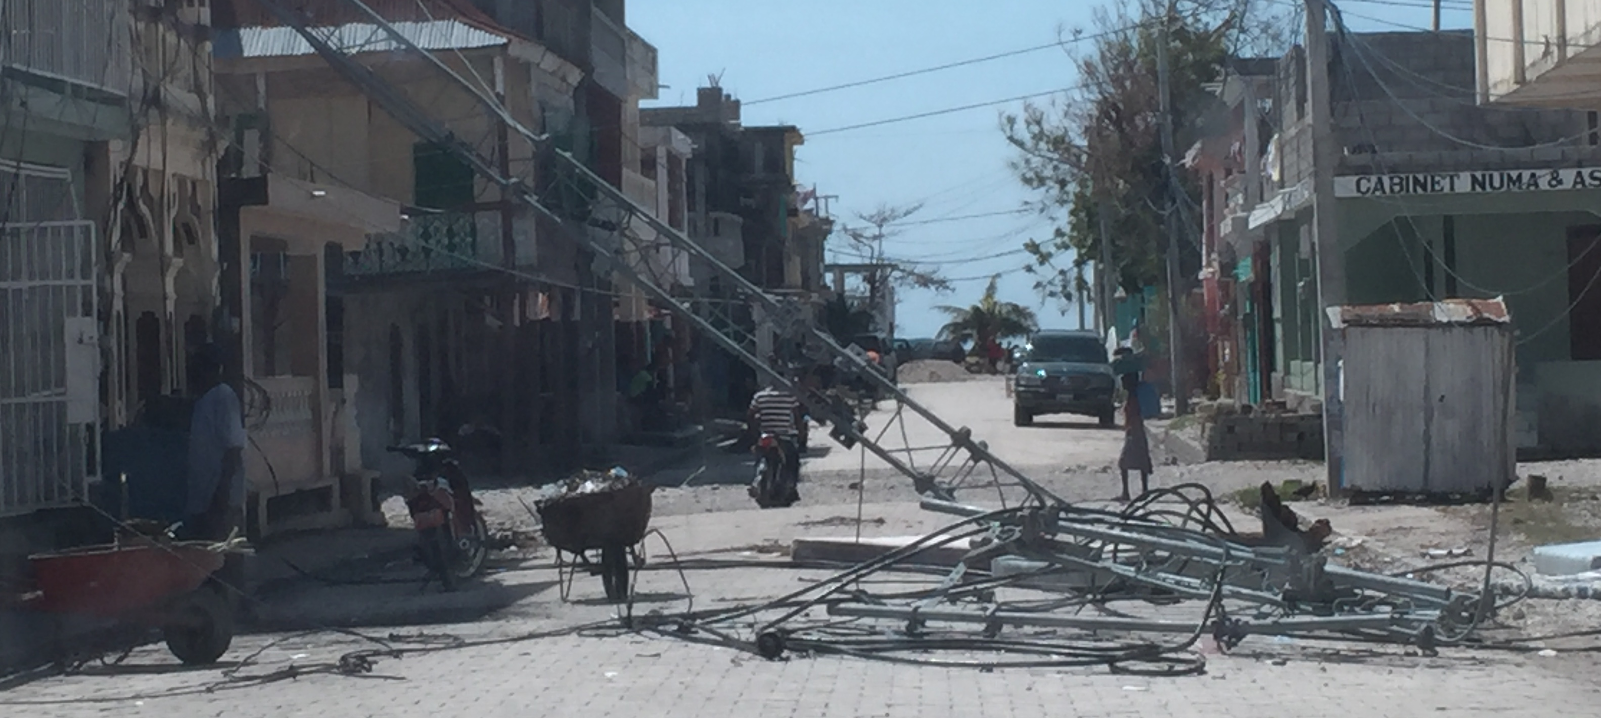
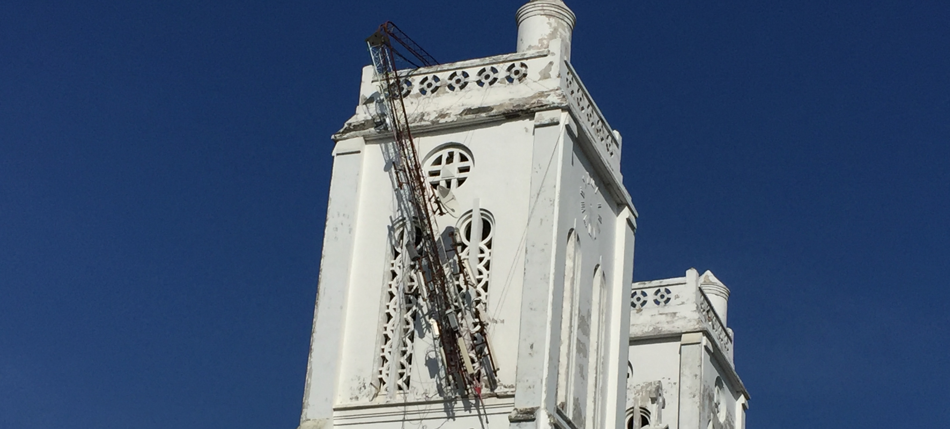
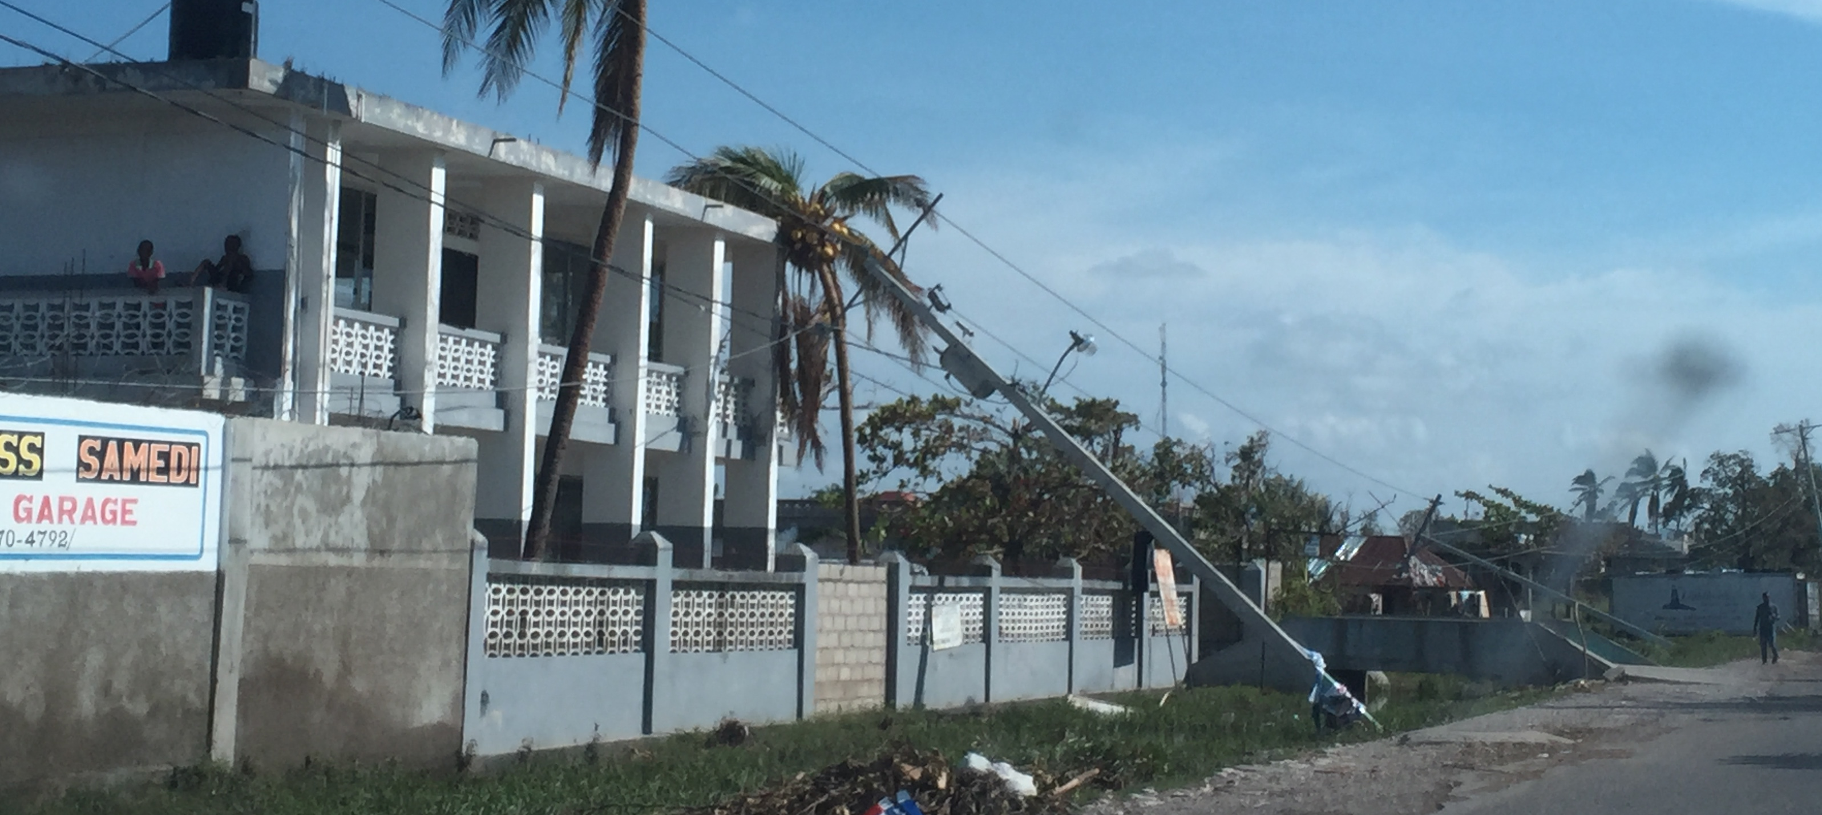
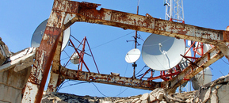
When Disaster Strikes…
…Telecommunication links are often disrupted and mobile networks are down
But there is an urgent need to establish effective communication links for disaster response and coordination,
  At a national level, between stakeholders involved in response and recovery
  At an international level, among international organizations and NGOs
  There is a need to improve international cooperation to ensure that connectivity is available in remote and rural areas, as well as in those parts of a country where existing telecommunications/ICT infrastructure has been destroyed.
Importation of telecommunications equipment is vital to re-establish communications that will help with humanitarian activities and recovery efforts. For some governments it is also critical to receive telecommunication equipment to help manage the disaster and ITU regularly supports governments, in particular with satellite equipment.
Notes:
​When disaster strikes, communications links are often disrupted, yet for relief workers who arrive on the scene these links are essential.
There is an urgent need to establish effective communication links for disaster response and coordination, at national and international level.

Slide 5
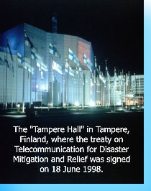
Tampere Convention
An international Treaty “on the Provision of Telecommunication Resources for Disaster Mitigation and Relief Operations”
Notes:
Communities affected by disasters will now be able to benefit from faster and more effective rescue operations, thanks to the Tampere Convention on the Provision of Telecommunication Resources for Disaster Mitigation and Relief Operations that came into force 8 January 2005. Until now, the trans-border use of telecommunication equipment by humanitarian organizations was often impeded by regulatory barriers that make it extremely difficult to import and rapidly deploy telecommunications equipment for emergency without prior consent of the local authorities. The treaty simplifies the use of life-saving telecommunication equipment.

Slide 6
Tampere Convention
Background
International Conference on Disaster Communications (Tampere, Finland, 1998), adopted the Tampere Declaration on Disaster Communication.
Based on 50 international regulatory instruments including the constitution of the ITU, calling for absolute priority to emergency life-saving communications.
United Nations General Assembly adopted resolution 46/182, for strengthening international coordination of humanitarian emergency assistance.
Notes:
The Tampere declaration stressed the need to create an international legal instrument on telecommunication provision for disaster mitigation and relief. This led to the Tampere Convention on the Provision of Telecommunication Resources for Disaster Mitigation and Relief Operations, in 1998.

Slide 7
Tampere Convention
Evolution
Tampere Convention was concluded in 1998
Came into force on January 8 of 2005
Currently, there are 60 signatories and 49 countries that have ratified the Convention.
  Signature: the signature does not establish the consent to be bound, it is a means of authentication and expresses the willingness of the signatory state to continue the treaty-making process.
  Ratification: defines the international act whereby a state indicates its consent to be bound to a treaty.
    Approval for the treaty on the domestic level and to enact the necessary legislation to give domestic effect to the treaty
More countries in various regions are working on the ratification of this treaty
Notes:
- The Tampere Convention was ratified by Cape Verde on 22 March 2018, bringing a total of 60 signatories on board. 49 have ratified the treaty.
Notes:
signature vs. ratification
Signature ad Referendum: A representative may sign a treaty "ad referendum", i.e., under the condition that the signature is confirmed by his state. In this case, the signature becomes definitive once it is confirmed by the responsible organ.[Art.12 (2) (b), Vienna Convention on the Law of Treaties 1969]
Signature Subject to Ratification, Acceptance or Approval: Where the signature is subject to ratification, acceptance or approval, the signature does not establish the consent to be bound. However, it is a means of authentication and expresses the willingness of the signatory state to continue the treaty-making process. The signature qualifies the signatory state to proceed to ratification, acceptance or approval. It also creates an obligation to refrain, in good faith, from acts that would defeat the object and the purpose of the treaty.[Arts.10 and 18, Vienna Convention on the Law of Treaties 1969]
Ratification: Ratification defines the international act whereby a state indicates its consent to be bound to a treaty if the parties intended to show their consent by such an act. In the case of bilateral treaties, ratification is usually accomplished by exchanging the requisite instruments, while in the case of multilateral treaties the usual procedure is for the depositary to collect the ratifications of all states, keeping all parties informed of the situation. The institution of ratification grants states the necessary time-frame to seek the required approval for the treaty on the domestic level and to enact the necessary legislation to give domestic effect to that treaty.

Slide 8
Tampere Convention
Evolution
Provides the legal framework for the use of telecommunications in international humanitarian assistance
Reduces regulatory barriers
Fully protects the interests of the States requesting and receiving international assistance. The host government retains the right to oversee and manage the international assistance
Foresees the establishment of bilateral agreements between the provider(s) of assistance and the State requesting/receiving such assistance

Slide 9
Tampere Convention
Basic principles
This Convention is based on the following basic principles:
Reduce regulatory barriers: signatories agree to reduce regulatory barriers to the transit of personnel, equipment, materials and information through the affected territory. Parties to the Convention agree to "reduce or eliminate regulatory barriers to the use of telecommunications resources for mitigation and disaster relief“.
Guarantee the necessary privileges, immunities and facilities for relief personnel and organizations providing telecommunications assistance, such as:
    Immunity from arrest, detention or prosecution;
    Immunity from confiscation or embargo of their equipment, materials and property;
    Exemptions from tax obligations and other charges (excluding VAT);
    Access to local facilities;
    Exemption from licensing requirements or fast tracking of licensing applications; and
    Protection of staff, equipment and materials.

Slide 10
Tampere Convention
Benefit
Puts in place a structure for managing requests for assistance
Creates mechanisms for establishing best practices, model agreements, etc.
Improves preparedness before disasters occur
Facilitates the deployment of telecommunications/ICT resources in the immediate aftermath of disasters
Protects the interests of beneficiary states

Slide 11
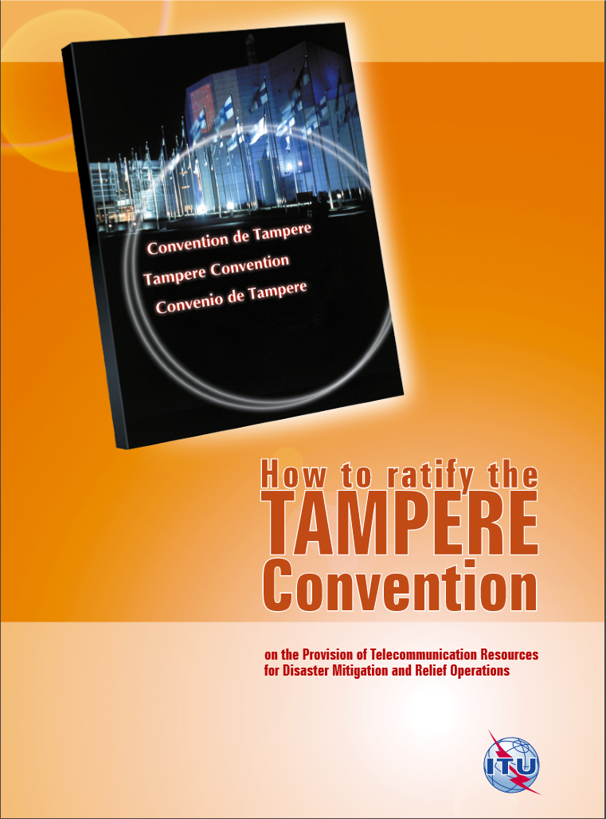
Tampere Convention
How to ratify?
When the Convention was adopted, a State could express its consent to be bound by the Convention by any of the following means:
  By definitive signature
  By signature subject to ratification, acceptance, or approval followed by deposit of an instrument of ratification, acceptance or approval
  By deposit of an instrument of ratification/accession
  Ratification process will depend on national ratificational procedures
Notes:
Signing a treaty does not mean the treaty is ratified and can be implemented in the state. By signing a treaty, a state expresses the intention to comply with the treaty. However, this expression of intent in itself is not binding. Once the treaty has been signed, each state will deal with it according to its own national procedures. For example, in some countries, parliamentary approval is required. After approval has been granted under a state’s own internal procedures, it will notify the other parties that they consent to be bound by the treaty. This is called ratification. After that the treaty is officially bind.
Reference: https://treaties.un.org/pages/ViewDetails.aspx?src=TREATY&mtdsg_no=XXV-4&chapter=25&clang=_en

Slide 12

Tampere Convention
Signing
WHO CAN SIGN?
Head of State/Government
Foreign Minister
Other designated official with the power of attorney
Notes:
To ratify the treaty, signature is needed if the state express its consent to be bound 1) By definitive signature or 2) By signature subject to ratification, acceptance, or approval followed by deposit of an instrument of ratification, acceptance or approval. Head of State/government, foreign minister and designated official with the power of attorney can sign the convention.

Slide 13
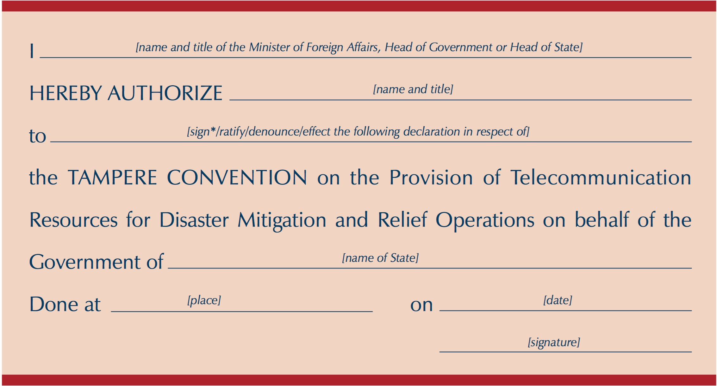
Tampere Convention
Sample of an instrument of full powers
After the domestic ratification process by the contracting parties of the Tampere Convention, the written instruments which provide formal evidence of consent to be bound, and also reservations and declarations, will be placed in the custody of a depositary.
For Tampere Convention, the Secretary-General of the United Nations acts as the depository.
Notes:
After the domestic ratification process by the contracting parties of the Tampere Convention, the written instruments which provide formal evidence of consent to be bound, and also reservations and declarations, will be placed in the custody of a depositary. The picture in the slide shows an example of an instrument of full powers.
Multilateral treaties usually designate an international organization or the Secretary-General of the United Nations as depositaries. For Tampere Convention, the Secretary-General of the United Nations acts as the depository.
The depositary must accept all notifications and documents related to the treaty, examine whether all formal requirements are met, deposit them, register the treaty and notify all relevant acts to the parties concerned.
The Convention shall enter into force thirty (30) days after the deposit of instruments of ratification, acceptance, approval or accession or definitive signature of thirty (30) States.

Slide 14
Tampere Convention
Examples of Reservation
When definitively signing, ratifying or acceding to this Convention or any amendment hereto, a State Party may make reservations.
A reservation is a declaration that the state reserves the right not to abide by certain provisions of the treaty.
Colombia
Reservation: “The Government of the Republic of Colombia formulates a reservation to paragraph 3 of article 11, by means of which Colombia does not consider itself bound by either of both of the dispute settlement procedures provided for in paragraph 3 of article 11.”
Ireland
Reservation: "Whereas to the extent to which certain provisions of the Tampere Convention on the Provision of Telecommunications Resources for Disaster Mitigation and Relief Operations ("the Convention") fall within the responsibility of the European Community, the full implementation of the Convention by Ireland has to be done in accordance with the procedures of this international organisation."
Luxembourg
Reservation: “To the extent to which certain provisions of the Tampere Convention on the Provision of Telecommunications Resources for Disaster Mitigation and Relief Operations fall within the area of responsibility of the European Community, the full implementation of the Convention by Luxembourg has to be done in accordance with the procedures of this international organisation."
Montenegro
Reservation: “In accordance with Article 14 of the Tampere Convention on the Provisions of Telecommunications Resources for Disaster Mitigation and Relief Operations, adopted at Tampere, 18 June 1998, the Government of Montenegro declares that this Convention shall not apply to:
To the extent to which certain provisions of the Tampere Convention on the Provisions of Telecommunications Resources for Disaster Mitigation and Relief Operations (“the Convention”) fall within the area of responsibility of the European Community, the full implementation of the Convention by Montenegro has to be done in accordance with the procedures of this international organization.”
Notes:
When signing, ratifying, accepting, approving or acceding to this Convention, a State may declare that it does not consider itself bound by either or both of the dispute settlement procedures provided for in para- graph 3 above. The other States Parties shall not be bound by a dispute settlement procedure provided for in paragraph 3 with respect to a State Party for which such a declaration is in force.
Reference：
Tampere Convention Article 11 paragraph 6:
If neither State Party seeks the good offices of another State Party, State, non-State entity or intergovernmental organization, or if the exercise of good offices fails to facilitate a settlement of the dispute within six (6) months of the request for such good offices being made, then either State Party to the dispute may:
a) request that the dispute be submitted to binding arbitration; or
b) submit the dispute to the International Court of Justice for decision, provided that both States Parties to the dispute have, at the time of signing, ratifying or acceding to this Convention, or at any time thereafter, accepted the jurisdiction of the International Court of Justice in respect of such disputes.
Article 14 :
1. When definitively signing, ratifying or acceding to this Convention or any amendment hereto, a State Party may make reservations.
2. A State Party may at any time withdraw its prior reservation by written notification to the depositary. Such withdrawal of a reservation becomes effective immediately upon notification to the depositary.

Slide 15
Tampere Convention
Process of Implementation
Implementation of Tampere differs for many countries, simplified process may look like:
  National Legislation on Tampere Implementation
  Awareness Creation – inform national stakeholders and agencies on the legislation and ensure its implementation
  Activation Process – when the Tampere is to be activated during disaster

Slide 16
Tampere Convention
Challenges
Lack of awareness and knowledge about the benefits of the convention
Long ratification procedures
No implementation processes
  Lack of coordination mechanisms at a national level
  Disconnect between those who ratified the treaty and customs (who are often not aware of the Convention and do not feel in a position to apply it when necessary)
                No national legislation on Tampere Implementation
                Absence of activation process
Notes:
Challenges for countries in signing, ratifying, and implementing the conventions.
Lack of awareness creation – inform national stakeholders and agencies on the legislation and ensure its implementation
Absence of activation process – when the Tampere is to be activated during disaster.

Slide 17
Tampere Convention
Additional Hurdles – Equipment shipping & distribution
Shipment protocols related to Lithium Batteries
Shipping agencies have varied understanding on battery shipment
Undue delays (limitations of shipping agencies) both anticipated and unforeseen (e.g. Covid)
Country’s logistic capacity
Regulatory hurdles
Notes:
In additional to Tampere convention, more hurdles to address in the actual equipment shipping and distribution:
Shipment protocols related to the Lithium Batteries: a number of shipping agencies also have varying perspectives on shipment – - some indicate that if the equipment comes in packages of two batteries per package they could be shipped. Others have total apprehension for shipping unless it is part of a special shipping consignment. It is also not clear as to the written protocols they have adopted when it is an emergency or humanitarian crisis.
there needs to be clear understanding among IATA and Regional counterparts, Airlines, travel agencies, Shipping agencies, Customs, Regulatory Authorities, Rapid Response Teams, Search and Rescue Teams, National Standards Bureau, Regional & International Humanitarian Responders and National Emergency and humanitarian Responders, on the clearly defined and understood protocols for the shipment of Lithium batteries in response to disasters.

Slide 18
Tampere Convention
Ways forward
Build capacity and raise awareness on the importance of this Treaty at a national/regional level
Develop implementation processes and mechanisms that can provide guidance to countries that have signed and ratify the convention
Prepare in advance a list of specific telecommunication resources and plans that an organization may have for the use of these resources to respond to a request for telecommunications assistance.
Create partnerships among organizations to work together towards creating an implementation framework

Slide 19
List of 49 countries
that have ratified the Tampere Convention
EUROPE | Netherland | Armenia | Uganda | Canada
Bulgaria | Belgium | CARIBBEAN AND THE PACIFIC | Liberia | Colombia
Czech Republic | Romania | Barbados | Guinea | El Salvador
Cyprus | Slovakia | Dominica | Burundi | Uruguay
Denmark | Spain | Saint Vincent and the Grenadines | Cape Verde | Nicaragua
Finland | Sweden | Tonga | ARAB STATES | Panama
Luxembourg | Switzerland | ASIA | Lebanon | Peru
Hungary | Iceland | India | Kuwait | Venezuela
Ireland | Montenegro | Pakistan | Morocco | NEXT… ?
Liechtenstein | United Kingdom of Great Britain and Northern Ireland | Sri Lanka | Oman
Lithuania | France | AFRICA | AMERICAS
Albania | CIS | Kenya | Argentina
Notes:
49 countries have signed and ratified the Tampere Convention, and may move to the implement phase of the Convention.
As said before, implementation of Tampere differs for many countries, simplified process may look like:
National Legislation on Tampere Implementation
Awareness Creation – inform national stakeholders and agencies on the legislation and ensure its implementation
Activation Process – when the Tampere is to be activated during disaster

Slide 20
List of 60 countries
that have signed the Tampere Convention*
EUROPE | Portugal | Commonwealth of Independent States | Congo | El Salvador
Bulgaria | Romania | Russian Federation | Gabon | Uruguay
Czech Republic | Slovakia | Tajikistan | Ghana | Honduras
Cyprus | Sweden | Uzbekistan | ARAB STATES | United States of America
Denmark | Switzerland | AFRICA | Lebanon | Nicaragua
Finland | Iceland | Niger | Kuwait | Panama
Estonia | Caribbean & the Pacific | Senegal | Morocco | Peru
Germany | Haiti | Mali | Mauritania | Venezuela
Italy | Marshall islands | Madagascar | Sudan | Chile
Hungary | ASIA | Kenya | Oman | Saint Lucia
Malta | Mongolia | Uganda | AMERICAS | Costa Rica
North Macedonia | Nepal | Benin | Argentina | NEXT…?
Poland | Sri Lanka | Chad | Canada
Netherland | India | Burundi | Brazil
*Countries that signed but not yet ratified the Convention are marked in red.
Notes:
There are 60 countries who have signed the Tampere conventions, however, 31 of them(marked in red) haven’t ratified the treaties.
There countries should ratify the convention to facilitate a smooth importation of telecommunications equipment and a better in emergencies.

Slide 21
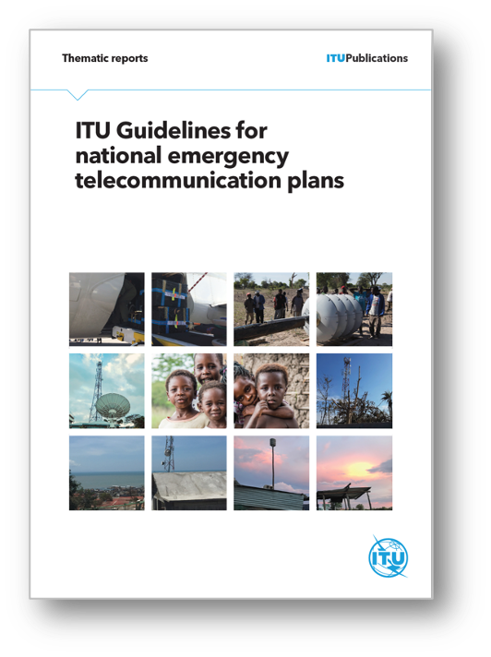
National Emergency Telecommunications Plan
A critical tool to assist policy makers and national regulatory authorities to develop a clear, flexible and user-friendly national emergency telecommunications plan with a multi-stakeholder approach. The guidelines can be used for developing tailored contingency plans for emergencies caused by natural hazards, epidemics and pandemics.
Notes:
An important complement to the Tampere Convention is the National Emergency Telecommunication Plan(NETP):
A National Emergency Telecommunication Plan (NETP) is an overall document that includes not only the regulatory framework for disaster risk management, but also all activities and actions that need to be developed and implemented in each of the phases of the disaster management cycle beyond the ICT sector. This includes the depiction of maps showing the location and types of hazards the country faces; understanding of the telecommunication/ICT landscape, operators and service providers, facilities availability and service penetration; the development of standard operating procedures and response and contingency plans; and the consideration of the treaties and international cooperation agreements signed by the country. Upon request, ITU is currently supporting countries to develop an NETP.

Slide 22
The UN Secretary General’s Roadmap for Digital Cooperation
The UN Secretary General’s Roadmap for Digital Cooperation has identified a set of recommendations on how the international community could work together to optimize the use of digital technologies and mitigate risks.
This includes (under the pillar of ‘connectivity’) to “Accelerate discussions on connectivity as part of emergency preparedness, responses and aid, including working through the inter-agency Emergency Telecommunications Cluster.”
The group of organizations working on this topic (ITU, ETC, UNHCR, GSMA) have identified an actionable framework that guides inclusive and meaningful connectivity in the context of emergency preparedness, resilience, and response. One of the six actions identified, is on the Tampere Convention, highlighting its usefulness to support emergency telecommunication support and equipment in times of disaster.
Notes:
Tampere Convention is also identified as one of the six actions in an actionable framework for UN SG’s roadmap for digital cooperation. The framework guides inclusive and meaningful connectivity in the context of emergency preparedness, resilience, and response.

Slide 23
Resources
Topic | Links
Tampere Convention | ITU Tampere Convention information page
 | Online Course in ITU Academy: Tampere Convention
 | UNTC - List of signatories/parties to the Tampere Convention
National Emergency Telecommunication Plans (NETPs) | Online course in ITU Academy: developing national emergency telecommunication plan
 | ITU Guidelines for national emergency telecommunication plans
 | National Emergency Telecommunications Plans: Enablers and Safeguards (GSMA)
Emergency Telecoms Preparedness Simulation Exercises | Emergency Telecommunications Table-Top Simulation Guide
 | TTX Simulation Exercise training via the ITU Academy
 | Crisis Connectivity Charter
Disaster Connectivity Maps (DCM) | ITU Disaster Connectivity Map page
 | Disaster Connectivity Map platform
ICT Assessments for emergencies | ETC-ITU Emergency Telecoms Preparedness Checklist
 | The GSMA - Connectivity, Needs and Usage Assessment (CoNUA) Toolkit
Notes:
The relevant resources for Tampere Convention and emergency telecommunications, with links.

Slide 24
Thank you!

